Slide 1




Slide 2



Harnessing the Strengths of a Multigenerational Workforce
Speaker:
Lisa Johnson of OperationsInc
AV Sponsor
Coffee Sponsor

Slide 3


Welcome & Thank You
to Our Sponsors
AV Sponsor
Coffee Sponsors

Slide 4

Harnessing the Strengths
of a Multigenerational Workforce
Lisa Johnson
VP Training & Development Services
(203) 595-4260
LJohnson@OperationsInc.com

Slide 5
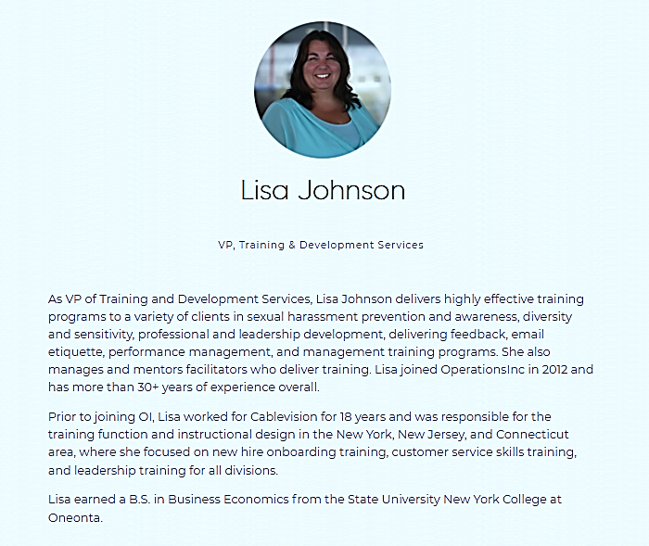
About
Your Facilitator

Slide 6

Logistics
Timing / Agenda
Phones – Turn Off / Set to Vibrate
Participate and Ask Questions

Slide 7
Agenda
The Different Generations at Work
Managing Multiple Generations
Exploring Generational Challenges
Strategies and Best Practices for Success

Slide 8
Generations
Notes:
Introduction – and goals for the next 6 months and if not, what are you looking to get out of this session.

Slide 9
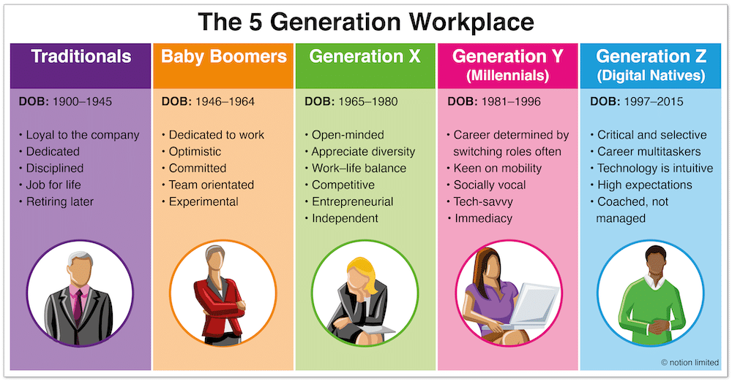
Generations
2019
Managing a Multi-Generational Workforce – CONFIDENTIAL – See disclaimer on limitations of use of these materials at the end of this deck.

Slide 10


Generational Stereotyping
When it comes to managing a team, the various generations are just one piece of the puzzle.
Remember, you’re not managing a generation, you’re managing individual people.
Perceptions dictate reality – even if they do not align with fact.
Misperceptions could lead you down a path of incorrect assumptions.
Gen X
Gen Z
Millennials
Boomers
Managing a Multi-Generational Workforce – CONFIDENTIAL – See disclaimer on limitations of use of these materials at the end of this deck.

Slide 11
Reflection – What Do You Think?
 | The Silent Generation | Baby Boomer Generation | Generation X | Generation Y or Millennials | Generation Z
Born | 1922–1945 | 1946–1964 | 1965–1980 | 1981–1996 | 1997–2019
Core values
Work ethic
Communication preferences
Feedback preferences
Stereotypes
Respect
Frugal
Community
Patriotic
Strong Work Ethic
Loyalty
Face to Face
Respect
Polite
Formal
Written
Private
Resistant to Tech
Resistant to Feedback
Resistant to Change
Managing a Multi-Generational Workforce – CONFIDENTIAL – See disclaimer on limitations of use of these materials at the end of this deck.

Slide 12
 | The Silent Generation | Baby Boomer Generation | Generation X | Generation Y or Millennials | Generation Z
Born | 1922–1945 | 1946–1964 | 1965–1980 | 1981–1996 | 1997–2019
Core values | Respect for authority Compliance Dutiful Custom | Optimism Acceptance Workaholism Stimulation | Stimulation Self-reliance Informality Skepticism | Realism Self-direction Goal-focused Purpose | Uniqueness Authenticity Creativity Shareability
Work ethic | Discipline Hard work Loyalty | Questions authority Self-centered Crusading causes | Task-oriented Autonomous Work-life balance | Multitasking "What's next?" Eagerness | Flexibility Self-reliant Personal freedom
Communication preferences | Written Formal | One-on-one Telephone | Direct Email Text messaging | Text messaging Social media | Digital natives Hand-held devices
Feedback preferences | No news is good news Take pride in a job well done | Not keen on feedback | Direct | Require lots Instantaneous | Bite-sized Immediate Real-time
Stereotypes | Old-fashioned Practical Rule followers | Ambitious Optimistic Wealthy | Self-centered Risk takers Cynical | Job hoppers Tech-dependent Work to live | Constantly connected Distracted Multitaskers

Slide 13
What Has Shaped Boomers?

Slide 14
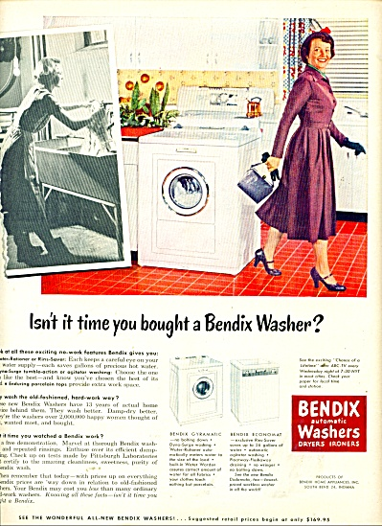
Baby Boomers
Baby Boomers grew up with TVs and saw shiny ads for new washing machines and cars.
Since they were not facing a war or depression like their parents' generation, Boomers knew that the harder they worked, the more they could buy.
Managing a Multi-Generational Workforce – CONFIDENTIAL – See disclaimer on limitations of use of these materials at the end of this deck.

Slide 15
Baby Boomers
In order to buy what the TV was selling:
Baby Boomers spent long hours being “seen” in the office (including evenings and weekends) and being loyal to one company.
This generation moved to and created suburbia.
  A land filled with uniformity.
  Living and working in an environment with structure and certainty is important to them.
Boomer employees tend to stay with a company for life, which can be why members of this generation often resist change.
Managing a Multi-Generational Workforce – CONFIDENTIAL – See disclaimer on limitations of use of these materials at the end of this deck.

Slide 16
What Do Boomers Value?

Slide 17
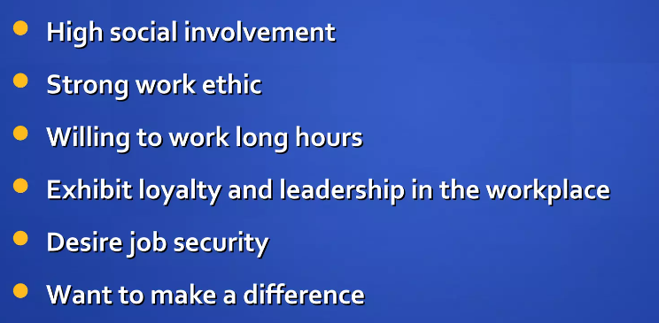
Baby Boomers – Value
Managing a Multi-Generational Workforce – CONFIDENTIAL – See disclaimer on limitations of use of these materials at the end of this deck.

Slide 18
What Do Boomers Expect?

Slide 19
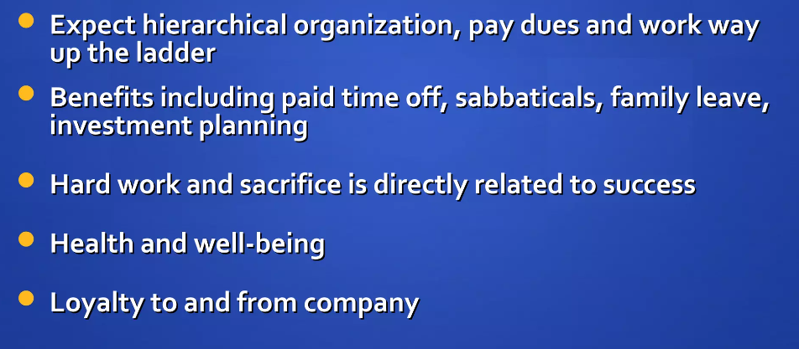
Baby Boomers – Expect
Managing a Multi-Generational Workforce – CONFIDENTIAL – See disclaimer on limitations of use of these materials at the end of this deck.

Slide 20
Best Practices for Communicating with
Baby Boomers

Slide 21
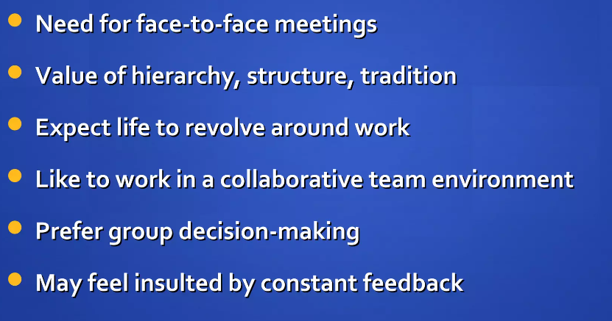
Best Practices – Baby Boomers
Managing a Multi-Generational Workforce – CONFIDENTIAL – See disclaimer on limitations of use of these materials at the end of this deck.

Slide 22
What Has Shaped Gen X?

Slide 23
Gen X
As the divorce rate and dual income families rose, Gen X-ers were left to look after themselves while both parents entered the workforce.
Gen X-ers tend to function well alone (latchkey kids).
A generation “raised” by the TV set.
Many have an entrepreneurial spirit and embrace change.
Because their parents put careers first, X-ers tend to have the opposite approach and place a strong emphasis on work-life balance.
Managing a Multi-Generational Workforce – CONFIDENTIAL – See disclaimer on limitations of use of these materials at the end of this deck.

Slide 24
Gen X
Gen X-ers thrive in casual, friendly work environments where they can do things their own way.
Gen X-ers grew up to be more compassionate, conscious, and connected to nature, spirituality, and family than their Baby Boomer parents.
Career focus and material prosperity.
Tend to follow the philosophy of work to live, while their parents tended to live to work.
Managing a Multi-Generational Workforce – CONFIDENTIAL – See disclaimer on limitations of use of these materials at the end of this deck.

Slide 25
What Does Gen X Value?

Slide 26
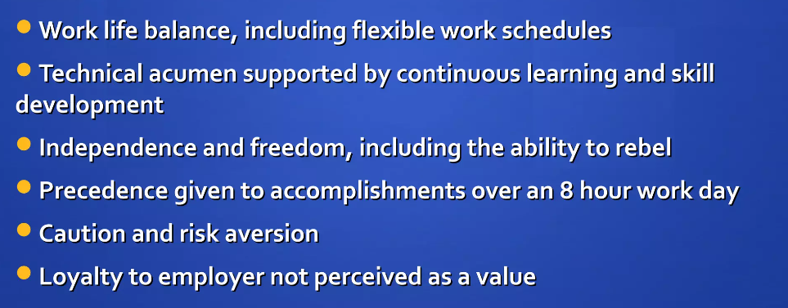
Gen X – Value
Managing a Multi-Generational Workforce – CONFIDENTIAL – See disclaimer on limitations of use of these materials at the end of this deck.

Slide 27
What Does Gen X Expect?

Slide 28
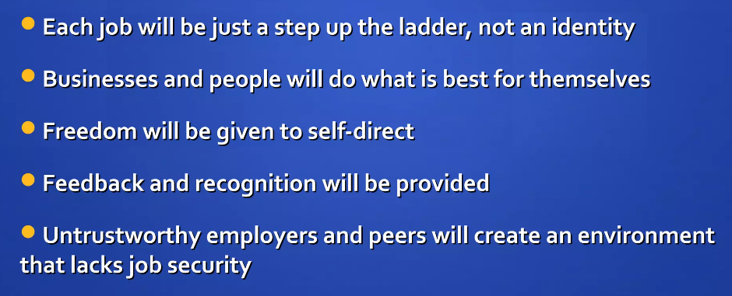
Gen X – Expect
Managing a Multi-Generational Workforce – CONFIDENTIAL – See disclaimer on limitations of use of these materials at the end of this deck.

Slide 29
Best Practices for Communicating with
Gen X

Slide 30
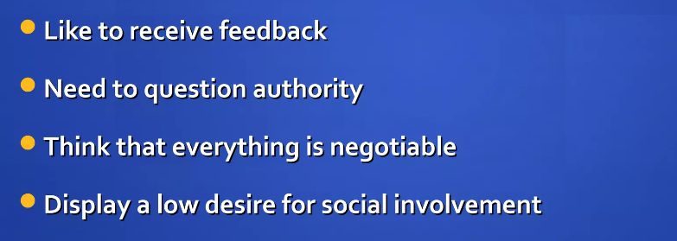
Gen X – Best Practices
Managing a Multi-Generational Workforce – CONFIDENTIAL – See disclaimer on limitations of use of these materials at the end of this deck.

Slide 31
What Has Shaped Millennials?

Slide 32

Millennials
More access to more information than any other generation before them.
Love an active environment.
Like to explore many functional areas in the organization – this will keep Millennials engaged in their work.
“Trophy Generation” – what does
this mean?
Excellent multi-taskers – stems
back to their childhood?
Collaborative vs. Competitive
Managing a Multi-Generational Workforce – CONFIDENTIAL – See disclaimer on limitations of use of these materials at the end of this deck.

Slide 33
Millennials
Millennials were the first generation of “kids with a schedule.”
Most diverse generation.
Most formally educated generation.
Entitled OR logical thinkers??
  Raised with technology, they may not understand why remote/hybrid isn't an option.
  If good health correlates to fewer sick days, why wouldn't a company have a gym or offer nutritious foods in its cafeteria?
Managing a Multi-Generational Workforce – CONFIDENTIAL – See disclaimer on limitations of use of these materials at the end of this deck.

Slide 34
What Do Millennials Value?

Slide 35
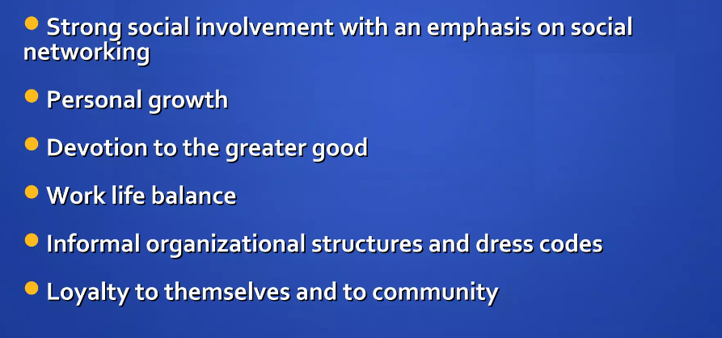
Millennials – Value
Managing a Multi-Generational Workforce – CONFIDENTIAL – See disclaimer on limitations of use of these materials at the end of this deck.

Slide 36
What Do Millennials Expect?

Slide 37
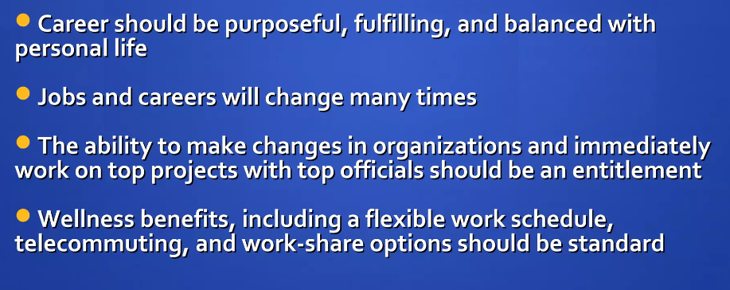
Millennials – Expect
Managing a Multi-Generational Workforce – CONFIDENTIAL – See disclaimer on limitations of use of these materials at the end of this deck.

Slide 38
Best Practices For Communicating with Millennials

Slide 39
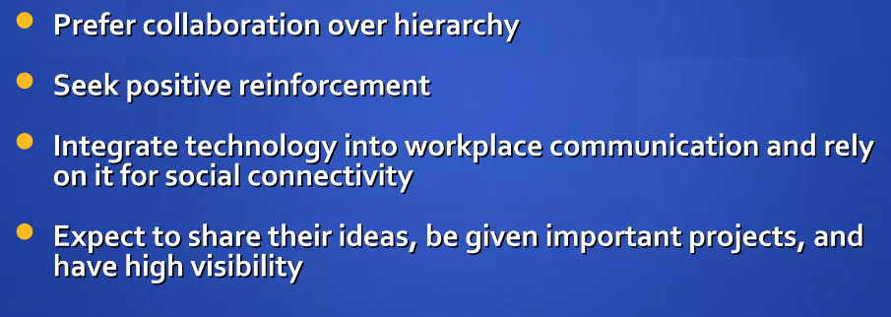
Millennials – Best Practices
Managing a Multi-Generational Workforce – CONFIDENTIAL – See disclaimer on limitations of use of these materials at the end of this deck.

Slide 40
What Has Shaped Gen Z?

Slide 41
Gen Z
Hyperconnected since childhood.
Web experience began in early childhood with Disney and Webkinz.
Mobile devices serve them in the classroom and office as their music player, video player, computer, and phone.
College attendance is predicted to fall for this group.
  High costs of education.
Able to absorb new information daily.
Independent, autonomous, environmentally aware.
Managing a Multi-Generational Workforce – CONFIDENTIAL – See disclaimer on limitations of use of these materials at the end of this deck.

Slide 42
What Does Gen Z Value?

Slide 43
Gen Z – Values
Work-Life Integration
Meaningful Work
Tech Savvy Environment
Entrepreneurial Opportunities
Feedback and Recognition
Managing a Multi-Generational Workforce – CONFIDENTIAL – See disclaimer on limitations of use of these materials at the end of this deck.

Slide 44
What Does Gen Z Expect?

Slide 45
Gen Z – Expect
Inclusive Culture
Transparent Communication
Workplace Wellness
Social Connectivity
Clear pathways for advancement, mentorship and development
Managing a Multi-Generational Workforce – CONFIDENTIAL – See disclaimer on limitations of use of these materials at the end of this deck.

Slide 46
Key Principles

Slide 47
Key Principles
Skills You Can Use
You can build trust and stronger working relationships by using a
set of core communication skills called Key Principles:
Maintain or enhance self-ESTEEM.
Listen and respond with EMPATHY.
Ask for help and encourage INVOLVEMENT.
SHARE thoughts, feelings, and rationale.
Provide SUPPORT without removing responsibility.
47
Leadership Essentials – CONFIDENTIAL – See disclaimer on limitations of use of these materials at the end of this deck.

Slide 48
EVERYONE BENEFITS: Self-ESTEEM
Baby Boomers: May appreciate recognition for their years of experience and contributions to the organization.
Millennials: Respond to regular feedback and recognition for their achievements. This can help reinforce their confidence and sense of accomplishment.
Gen X: May benefit from opportunities to showcase their expertise and leadership skills. Providing them with autonomy and decision-making authority can help boost their confidence and self-esteem.
Gen Z: Fostering a supportive and inclusive work environment where they feel valued and respected can contribute to their sense of self-worth.
48
Leadership Essentials – CONFIDENTIAL – See disclaimer on limitations of use of these materials at the end of this deck.

Slide 49
Millennials and Gen Z: EMPATHY
Millennials: They value meaningful work and want to feel like they are making a difference in the world. Empathy from leaders and colleagues can help reinforce their sense of purpose and fulfillment in their roles.
Gen Z: They are early in their careers and may be navigating new challenges or uncertainties. Showing empathy can help them feel supported and valued as they develop their skills and expertise.
49
Leadership Essentials – CONFIDENTIAL – See disclaimer on limitations of use of these materials at the end of this deck.

Slide 50
Millennials and Gen Z: INVOLVEMENT
Millennials: Millennials grew up during a time of rapid technological advancement and societal change. They are accustomed to having access to information and being involved in decision-making processes in their personal lives. They want to feel that their opinions and perspectives are valued and considered in the workplace.
Gen Z: Many Gen Z individuals are entrepreneurial-minded and value opportunities to take initiative and contribute to meaningful projects. Being involved in decision-making allows them to leverage their creativity and innovation in the workplace.
50
Leadership Essentials – CONFIDENTIAL – See disclaimer on limitations of use of these materials at the end of this deck.

Slide 51
Gen X: SHARE
Gen X: They tend to value understanding the big picture and their role within it. Gen Xers are known for their skepticism towards traditional authority and hierarchy. They prefer to understand the rationale behind decisions and how they fit into the larger organizational structure. Because they are results-oriented, knowing the big picture helps them stay aligned with organizational goals and measure their progress toward success.
51
Leadership Essentials – CONFIDENTIAL – See disclaimer on limitations of use of these materials at the end of this deck.

Slide 52
Millennials: SUPPORT
Millennials: They value mentorship and guidance in their careers. They appreciate managers who provide support and advice to help them navigate challenges, develop their skills, and advance in their careers.
52
Leadership Essentials – CONFIDENTIAL – See disclaimer on limitations of use of these materials at the end of this deck.

Slide 53
Final Thoughts

Slide 54
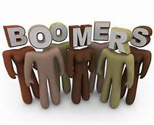

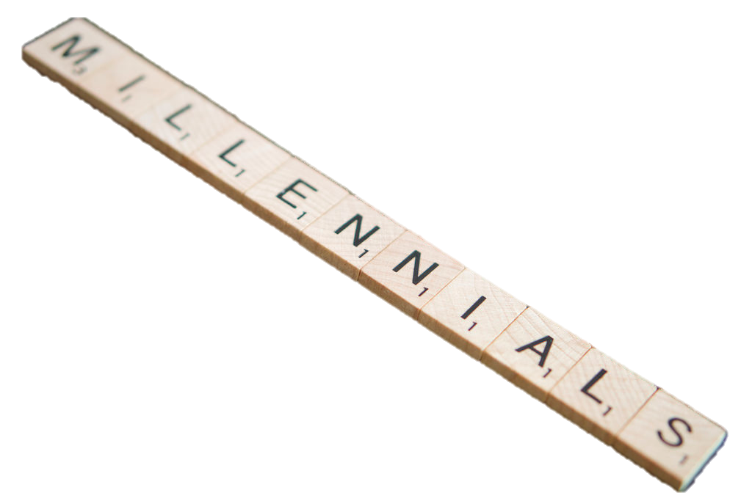
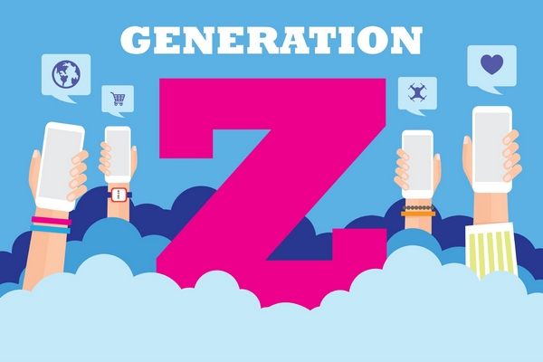
Communication Techniques
When leading different generations, there are some commonalities tied to how different age groups are used to communicating with others.
How you communicate is only one part of the picture.
Make sure that you personalize your message so any employee, no matter what their age, is excited to do the best job possible.
Managing a Multi-Generational Workforce – CONFIDENTIAL – See disclaimer on limitations of use of these materials at the end of this deck.

Slide 55
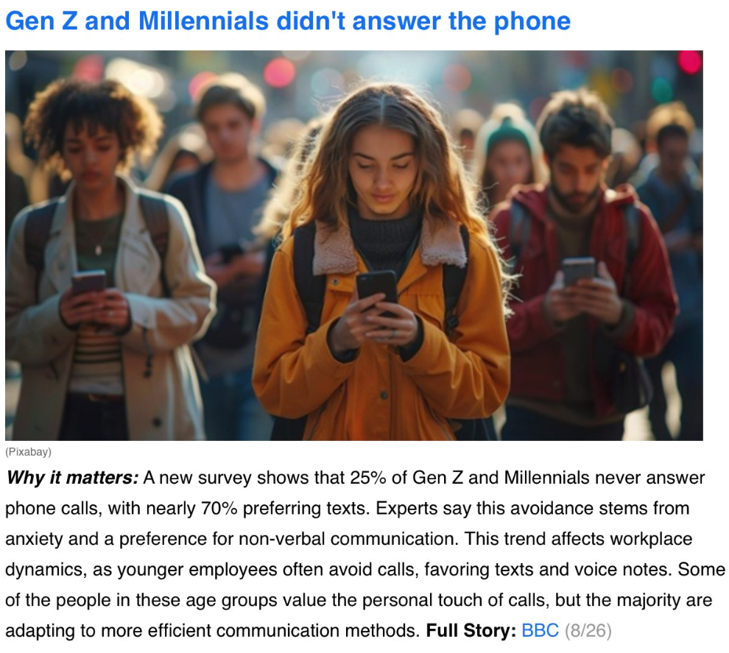
Managing a Multi-Generational Workforce – CONFIDENTIAL – See disclaimer on limitations of use of these materials at the end of this deck.

Slide 56
THANK YOU
LJohnson@operationsinc.com

Slide 57
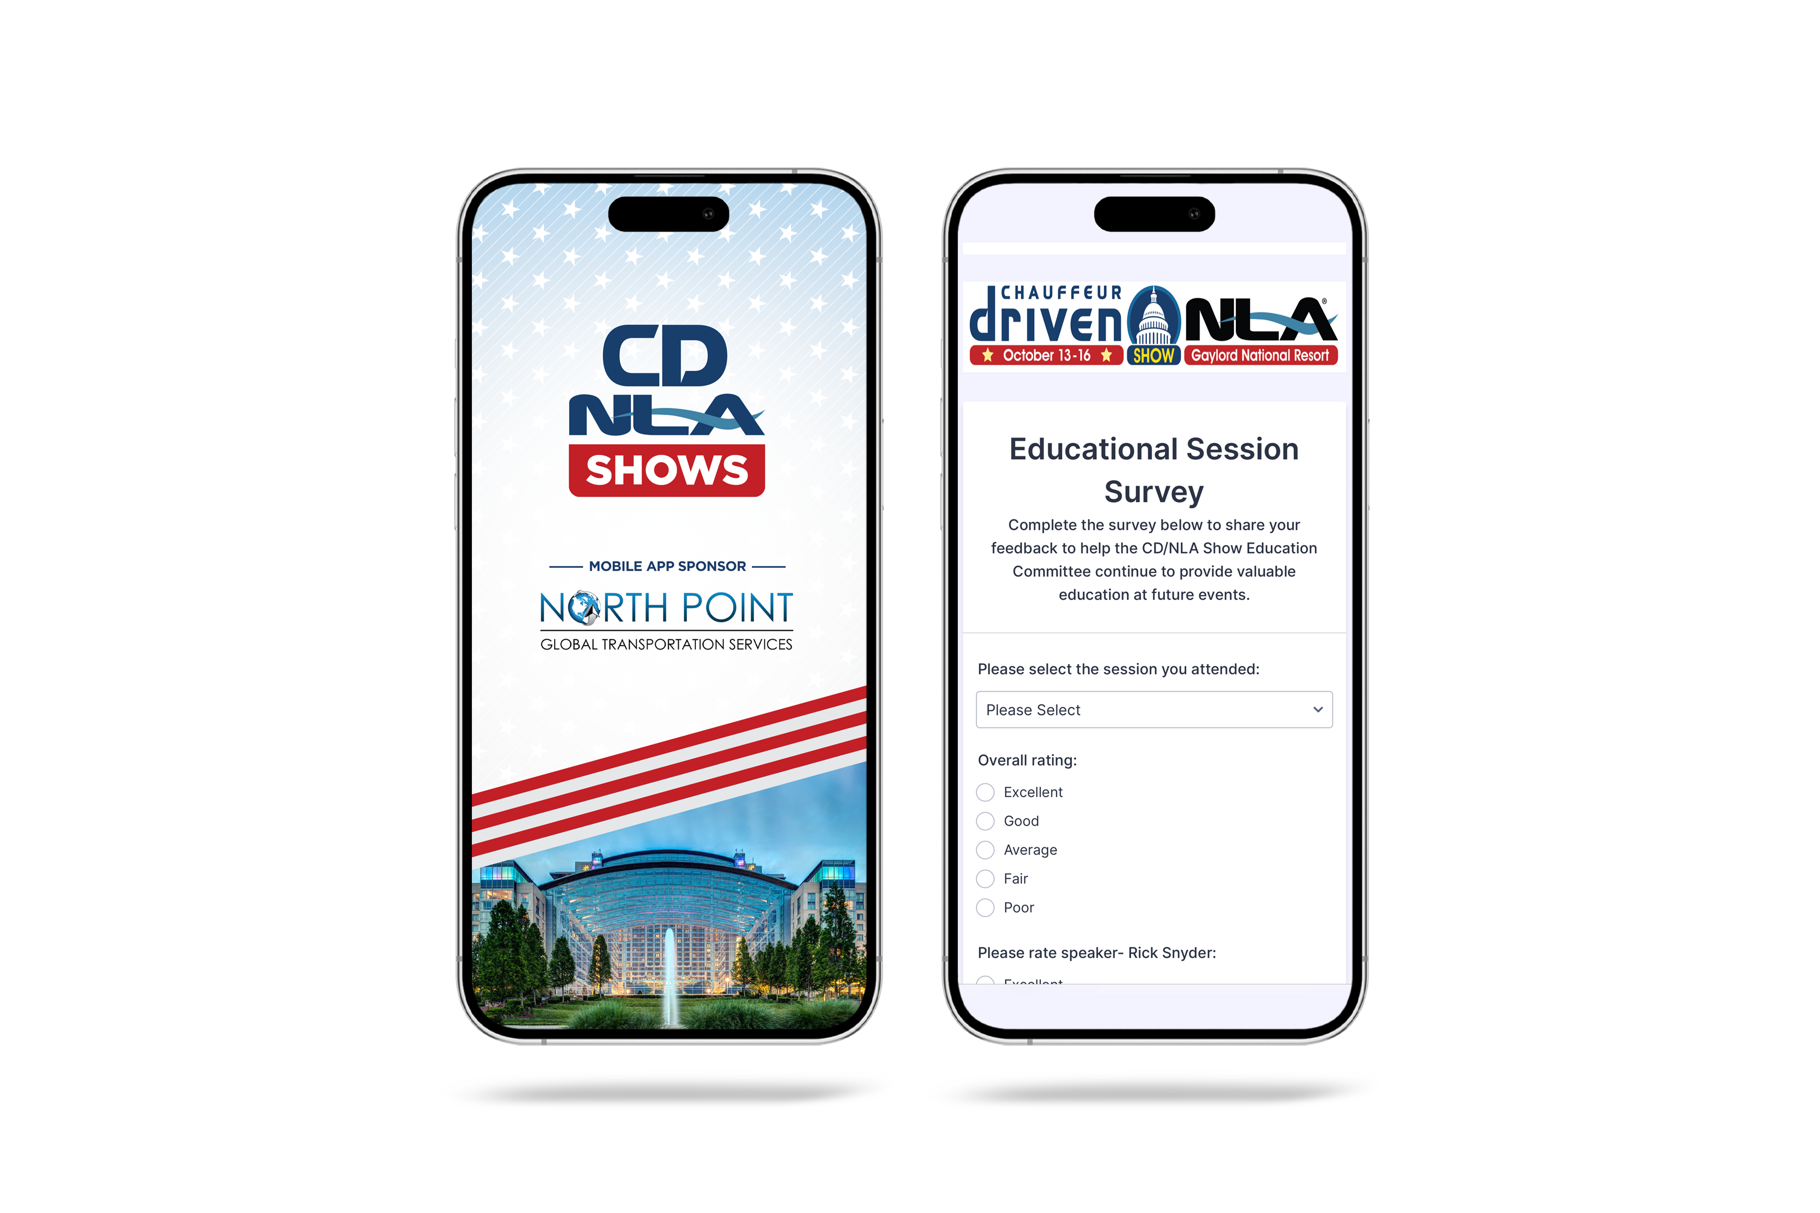
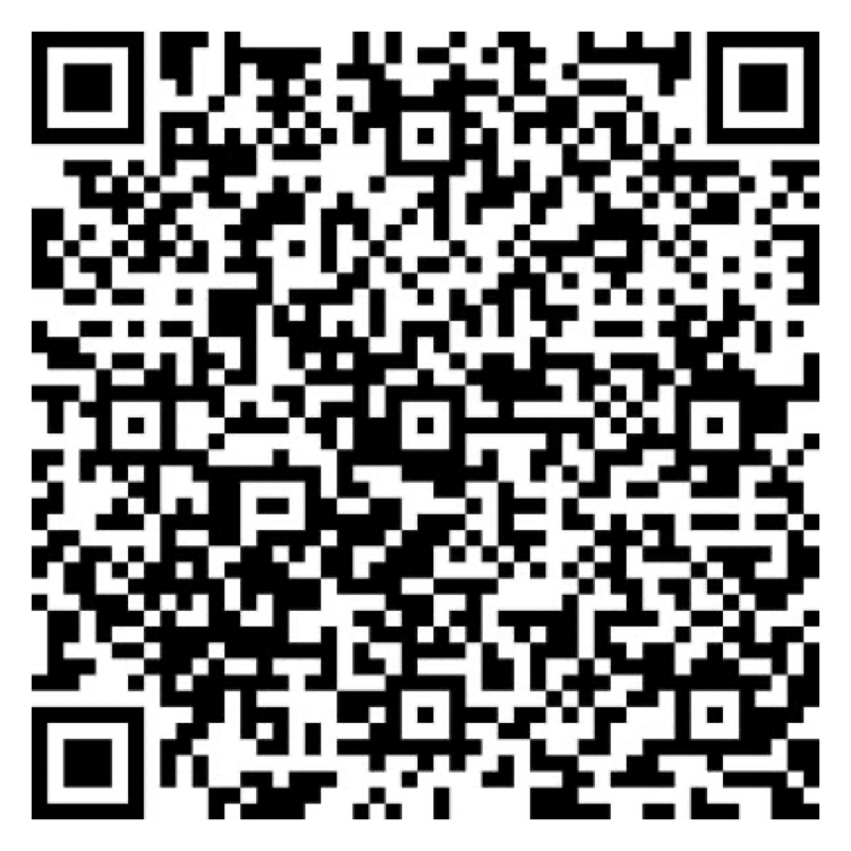

Let Us Know How
We Did!
Fill Out the Survey
AV Sponsor
Coffee Sponsor

